Slide 1

ME 617: Manufacturing of Polymers and Polymer Composites
Tensile Behaviour of CNTs(0.25%) based Carbon/Glass Reinforced Hybrid Composites
Presented by:
Name and Roll No: P Venumadhav (234103428)
Anjeet Kumar (234103407)
Digvijay Thakare (234103415)

Slide 2
Content
Abstract
Introduction
Methodology
Results
Conclusions
References
Acknowledgement

Slide 3
Abstract
Background: Hand-Lay up is one of the methods in manufacturing FRP.
Objective(s): Perform Hands-on work on Hand Lay-up with vacuum bagging and perform various Mechanical Tests to study the behavior of samples.
Methods: Studying and applying the theoretical knowledge of Hand-lay up with Vacuum Bagging method to fabricate GFRP+ CFRP and performing tests on 3 pt. Bending test and tensile test.
Results: Analyzing the data and graphs obtained from UTM to determine various mechanical parameters
Conclusion:

Slide 4
Introduction
Background:- The hand lay-up method is one of the oldest and most commonly used techniques for manufacturing composite materials. This method uses less manpower and is comparatively simpler than other methods.
Objectives:- To understand the step-by-step process of the hand lay-up method and investigate key (Mechanical) parameters.
Aiming to study and enhance the quality and efficiency of composite parts production by addressing factors influencing mechanical properties and process streamlining.

Slide 5
Importance and relevance of the research:- To understand the mechanical behavior of the composite, comparing the results of the tensile test and 3-point bending test with other manufacturing methods and FRP combination.

Slide 6
Methodology
In this method, reinforcing fibers are manually placed onto a mold surface and impregnated matrix, and Vacuum bagging is used to remove air and excess resin from the laminate.
5 Layers of Carbon Fiber ( 250*250 mm) & Glass Fiber ( 250*250 mm) each, Were arranged in a unidirectional form.
Epoxy raisin + Hardener mixture used as matrix (10:1 ratio).
A Layer of Reinforcement laid and matrix mix. Was applied.
The Process was carried out for each layer.
Finally, Vacuum Bagging was done to remove the excess mixture and kept for 24 hrs/ for curing

Slide 7
The Final Sheet was cut into strips of 80mm*25mm for Tensile and 3-point bending test.
ASTM Was followed for the testing on UTM to get the results.

Slide 8
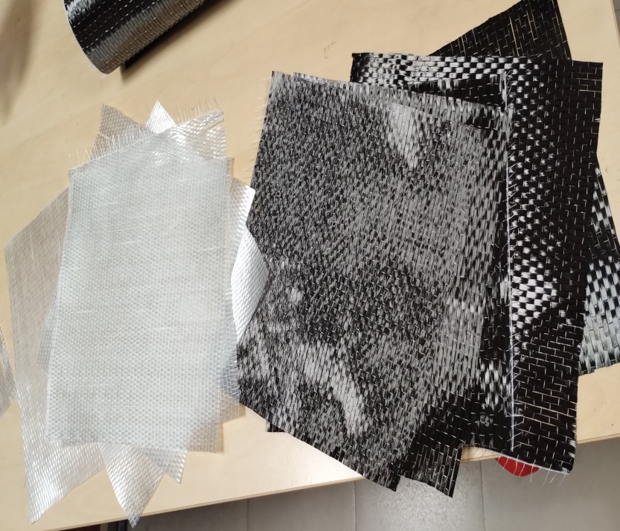
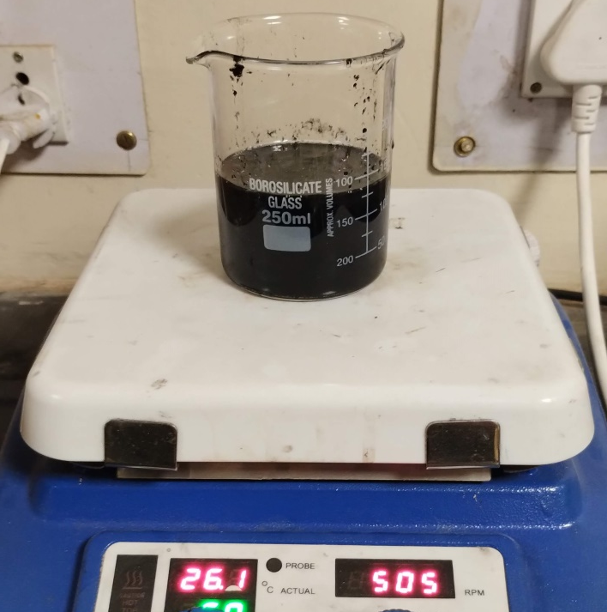
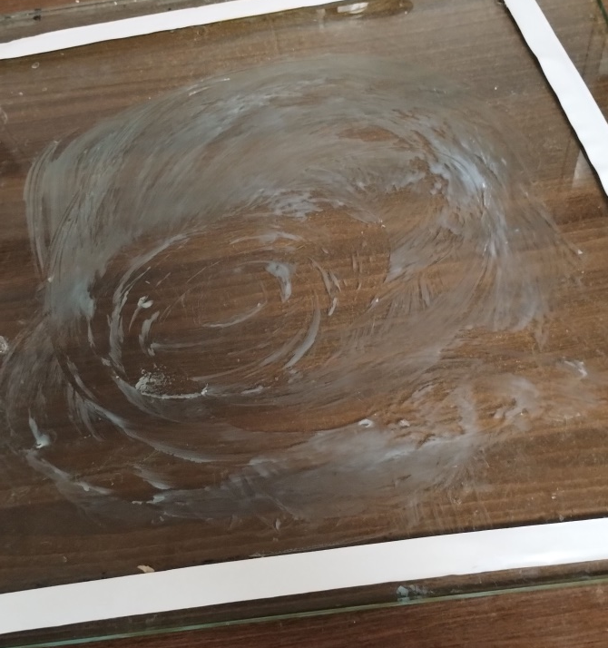
CF & GF Layers in desired Dimensions
Mixing of Hardener & Raisin Mixture
Wax Layer for easy releasing Applied on Mould (Glass)

Slide 9
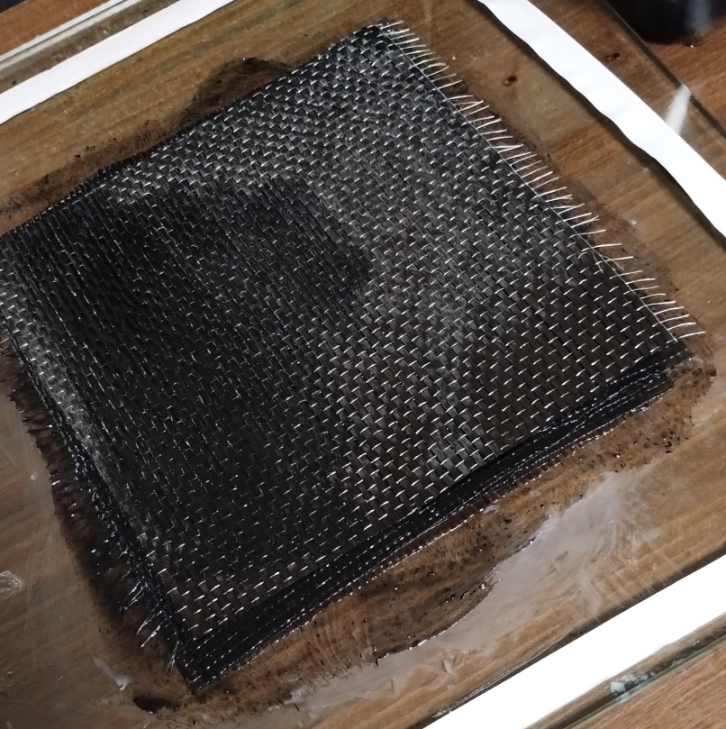
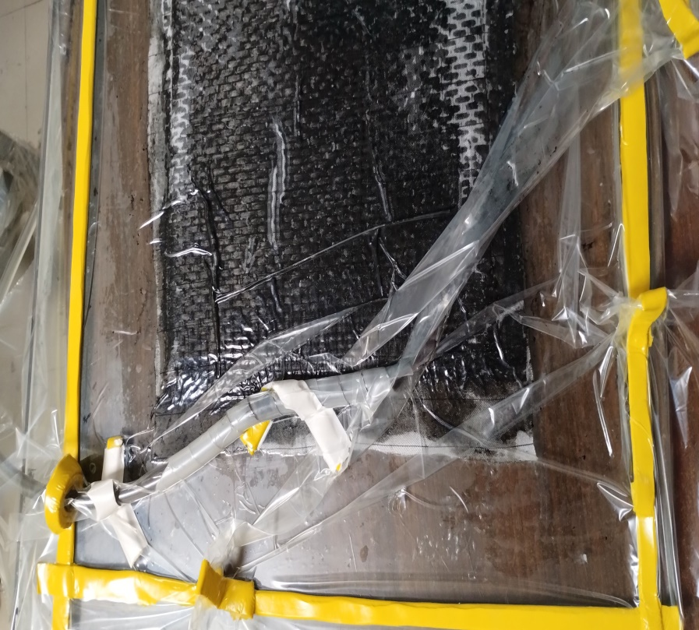
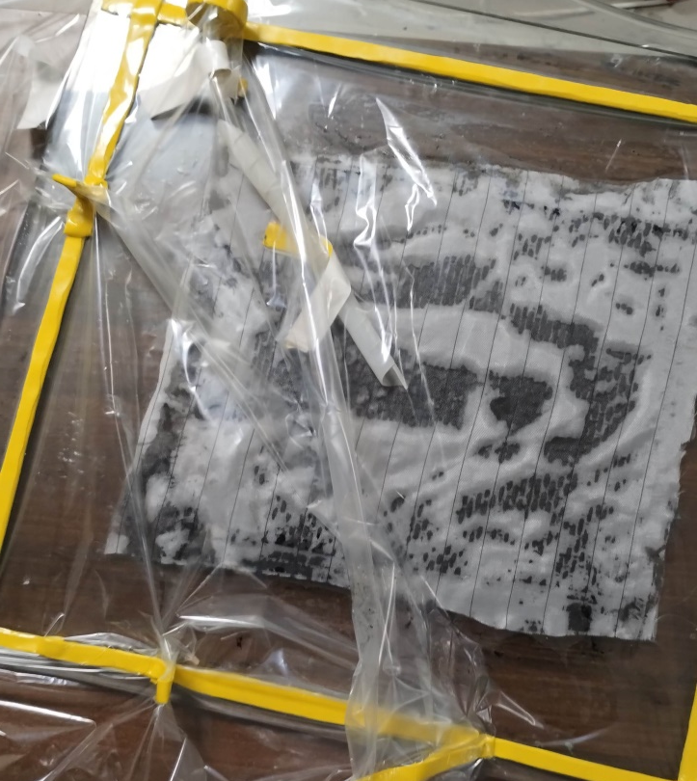
      Final Application of Mixture on Fiber Layers- Unidirectional Orientation
Vacuum Bagging- Initial Stage
Vacuum Bagging- Final Stage

Slide 10
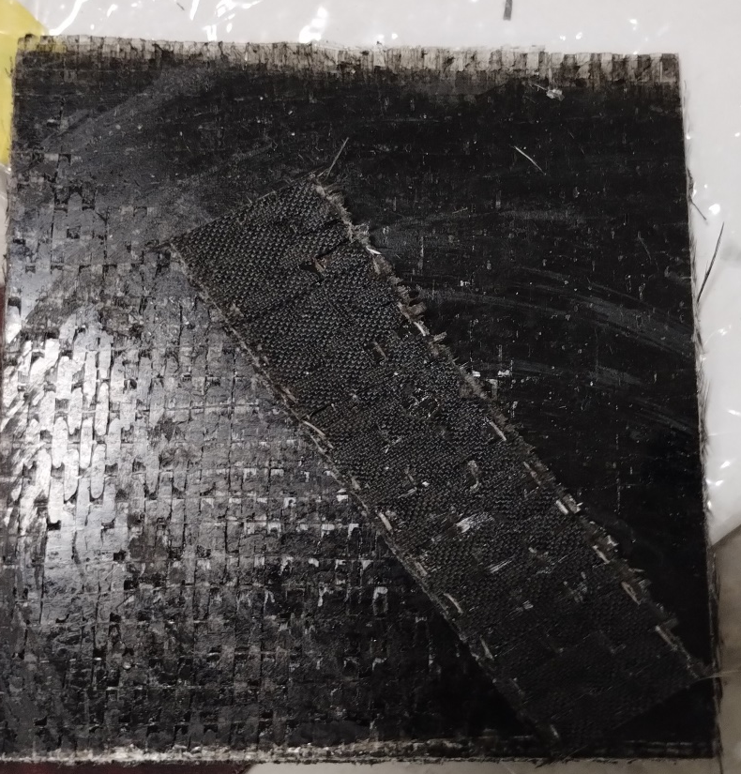

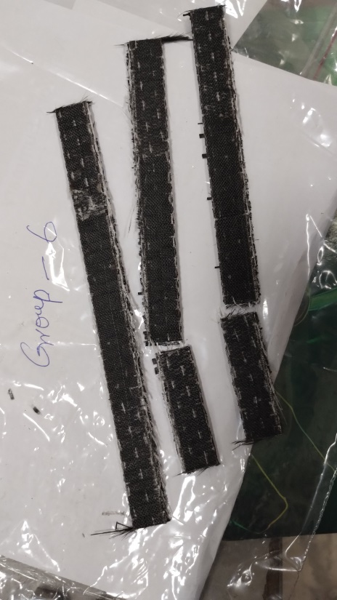
Final Laminate of Carbon Fiber + Glass Fiber
Strips cut by Shear cutter for Testing
Raw Material

Slide 11
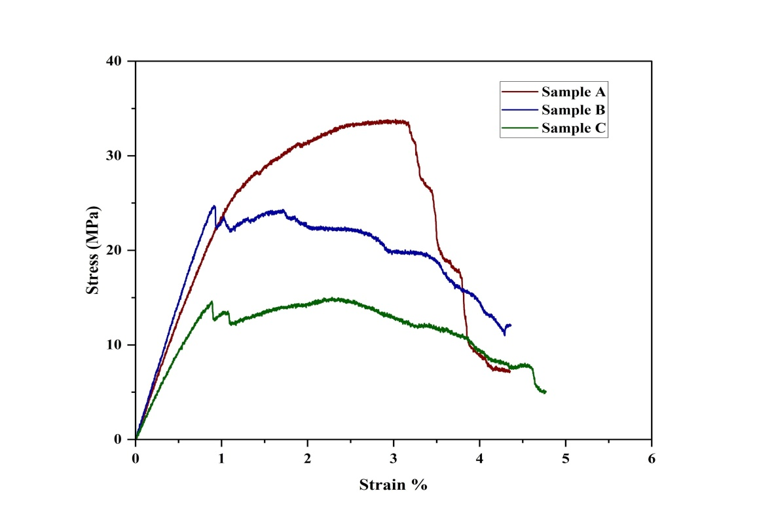
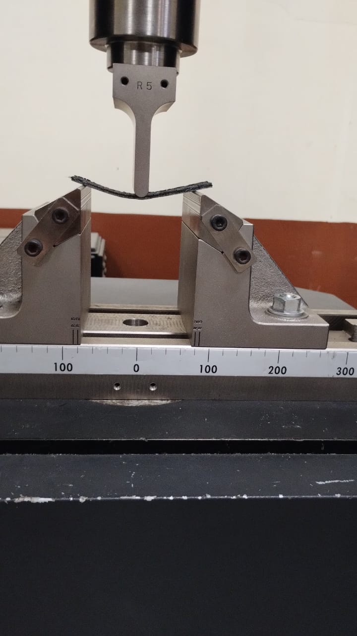
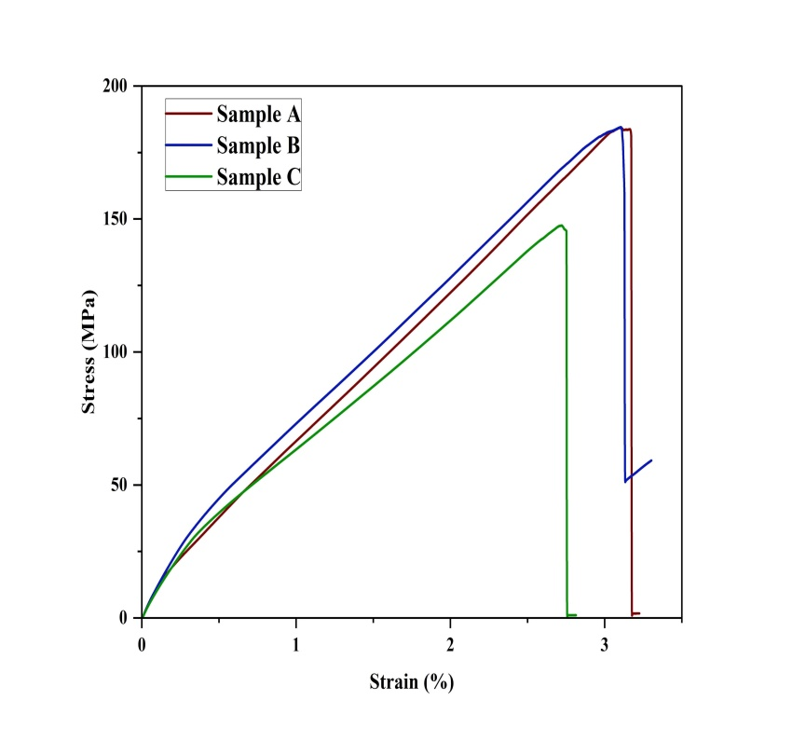
Results
3 Point Bending Test
Tensile Test

Slide 12
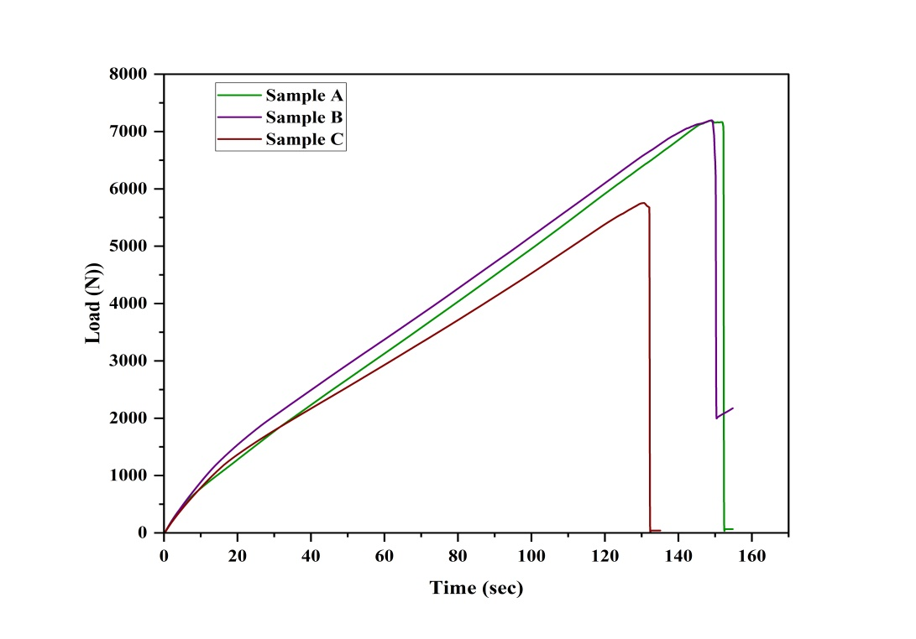
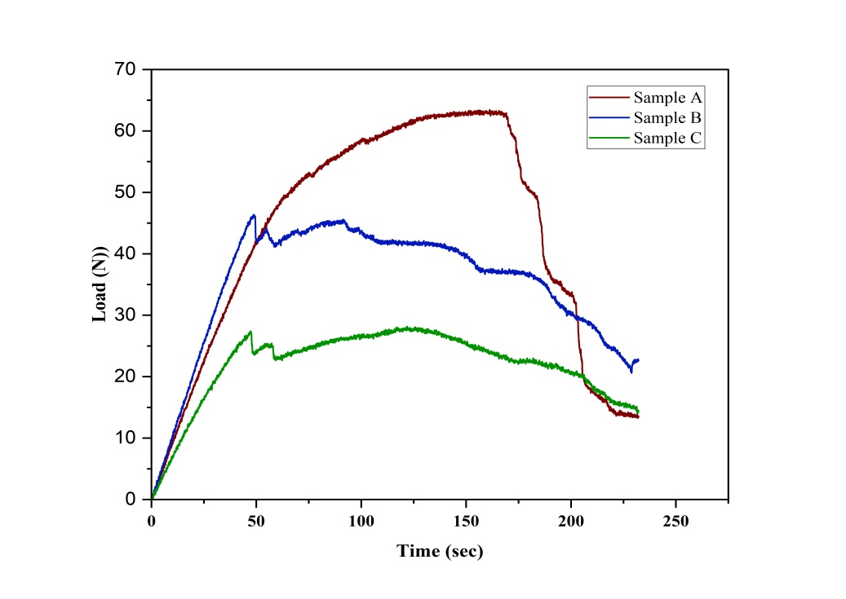
Cont.
Load vs time
for tensile test
(b)Load vs time
for 3 point bending test

Slide 13
Conclusions
Tests were performed and graphs were plotted.
The average load the specimen can bear during tensile test is around
6250N and for 3 point bending test it is 40N.
Stress strain graph has been plotted from which properties such as Young modulus of the composite can be found.

Slide 14
References
Class notes and materials from course ME 617

Slide 15
Acknowledgments
Special thanks to our course instructor Ujendra Kumar Komal sir who taught the course so well, which helped us to understand the experiments well.
Special thanks to Paladugu Rakesh who helped us in experiments.

